Slide 1
PONG
Reinventing a Classic Arcade Game
Mechatronics S25
Prof. Kapila
Greta Perez-Haiek, Aadhav Sivakumar, Nathan Smurthwaite
Notes:
Greta, Nate, Aadhav

Slide 2
01
What’s the Problem?
Notes:
Greta

Slide 3
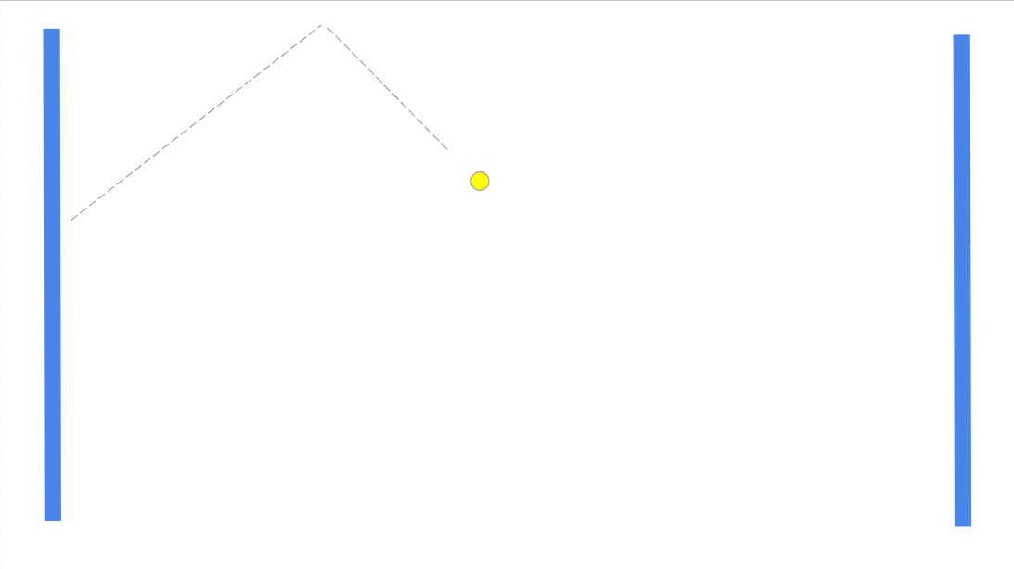
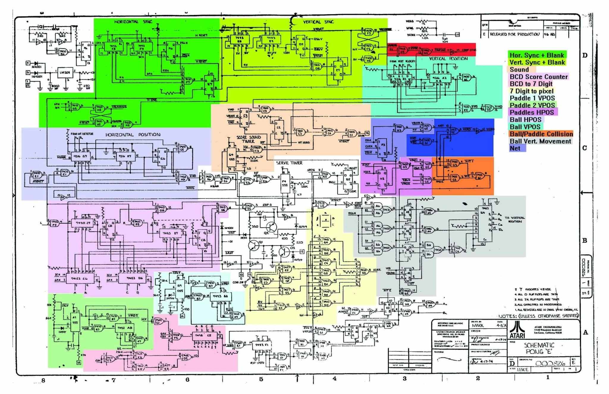
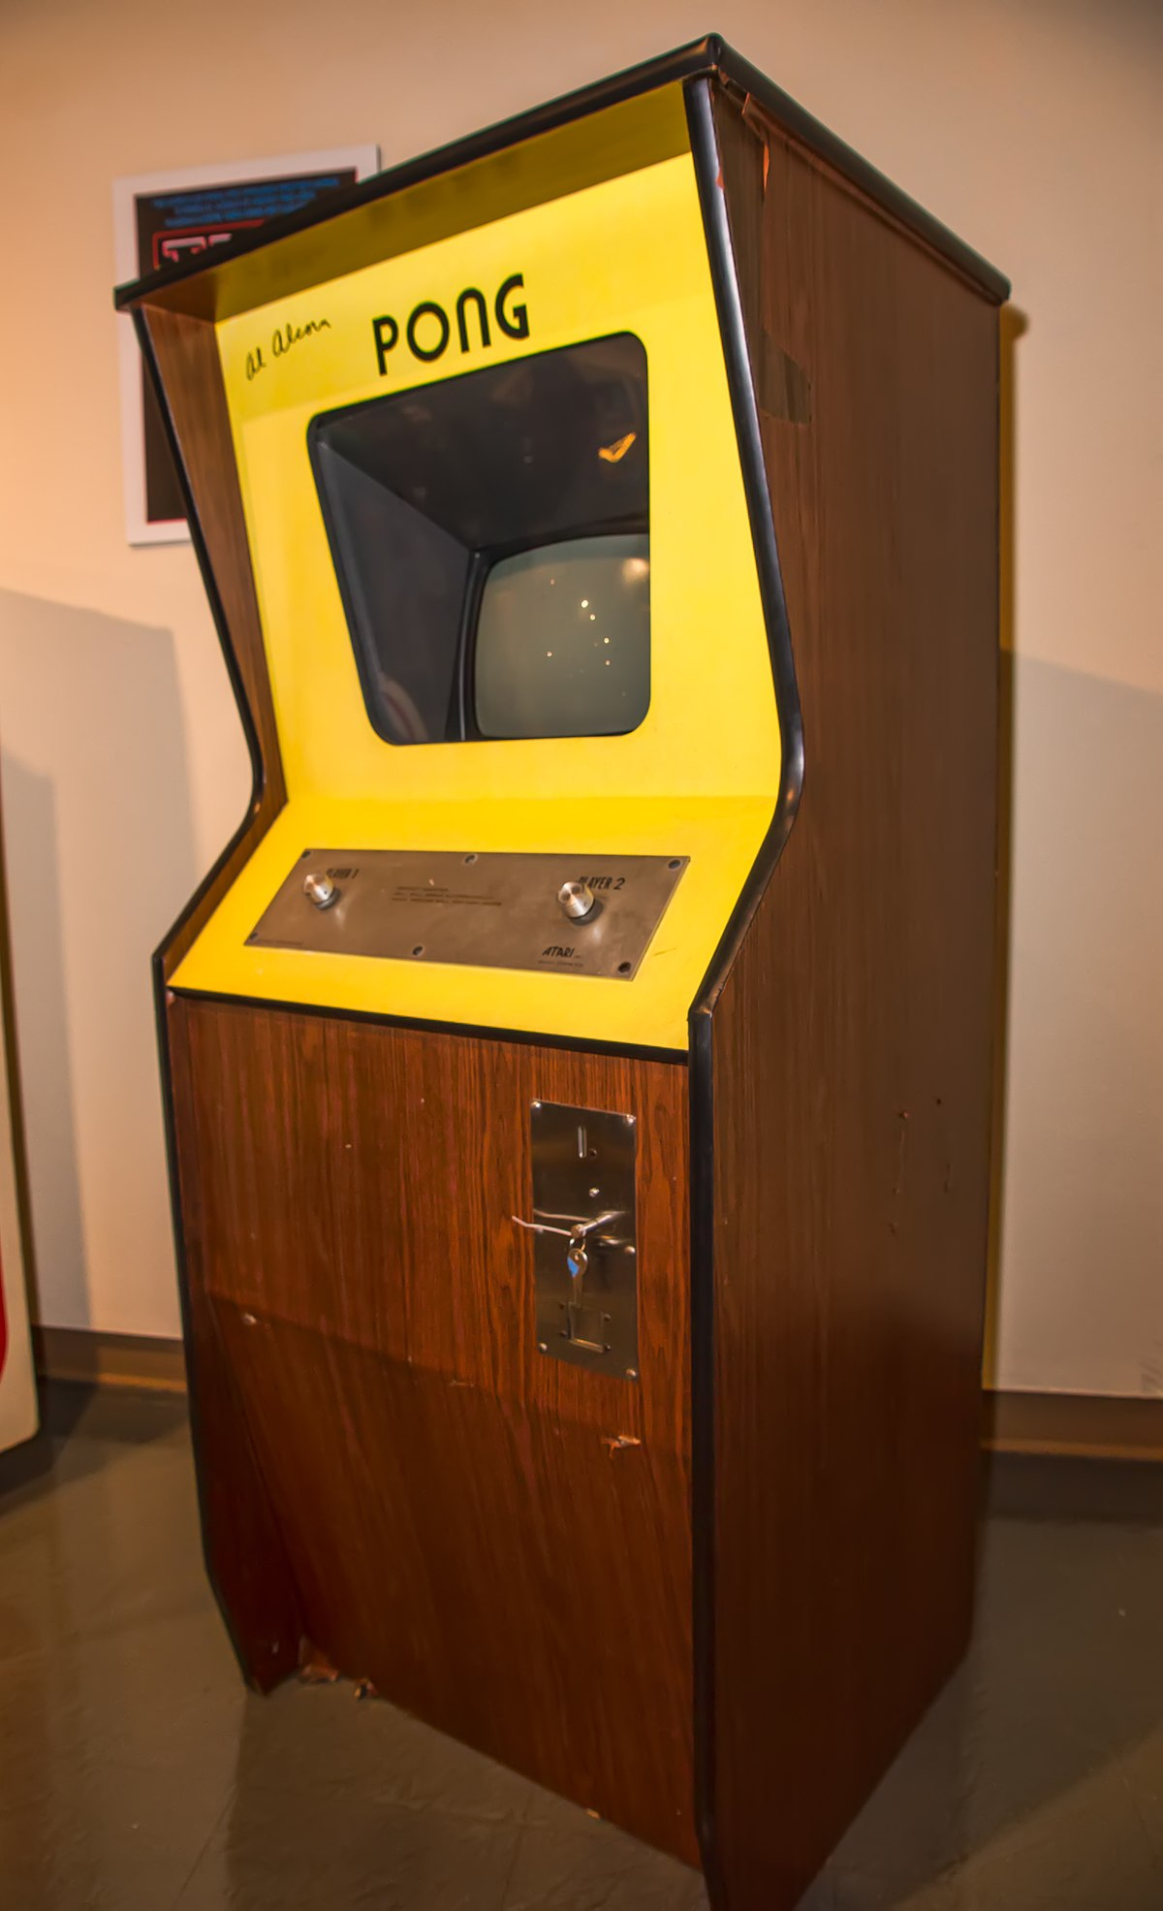
The early days of Pong were entirely analog…
… No microcontroller or programmable device in sight.
Notes:
Greta

Slide 4
02
What’s the Solution?
Notes:
Greta

Slide 5
Recreate the game in a LESS complex manner and with LESS components
Notes:
Greta

Slide 6
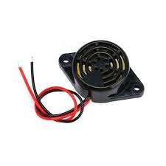
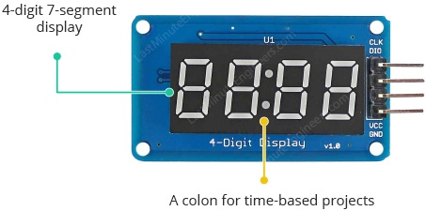
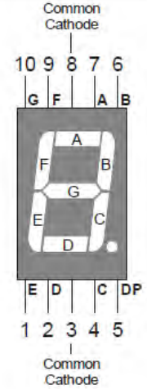
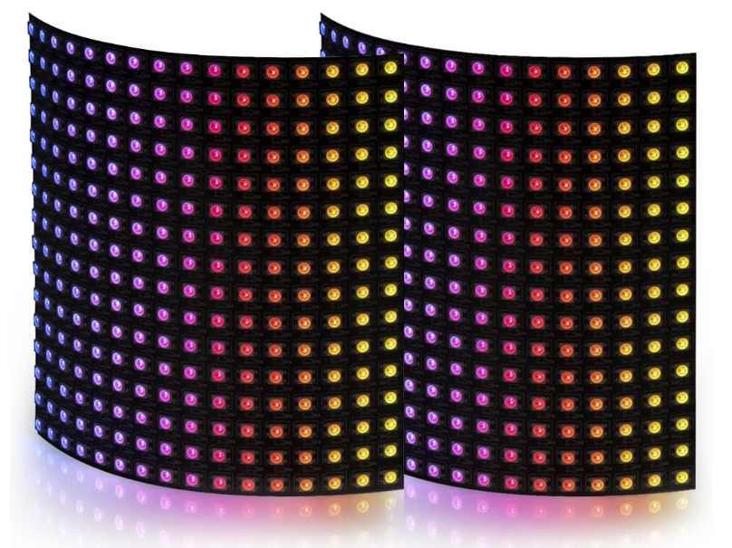
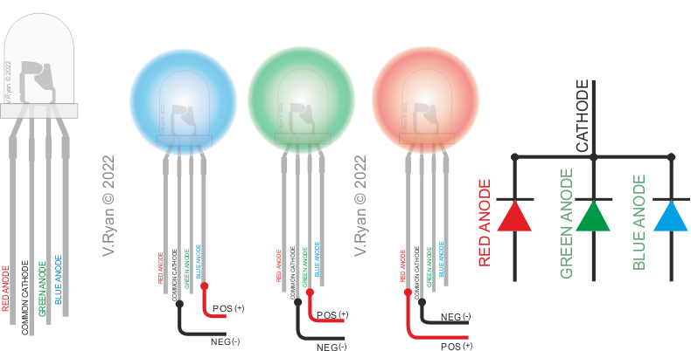
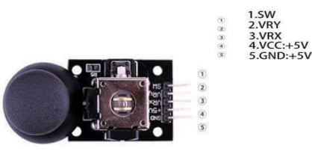
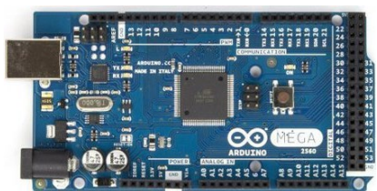
The
Components
Notes:
Nate

Slide 7
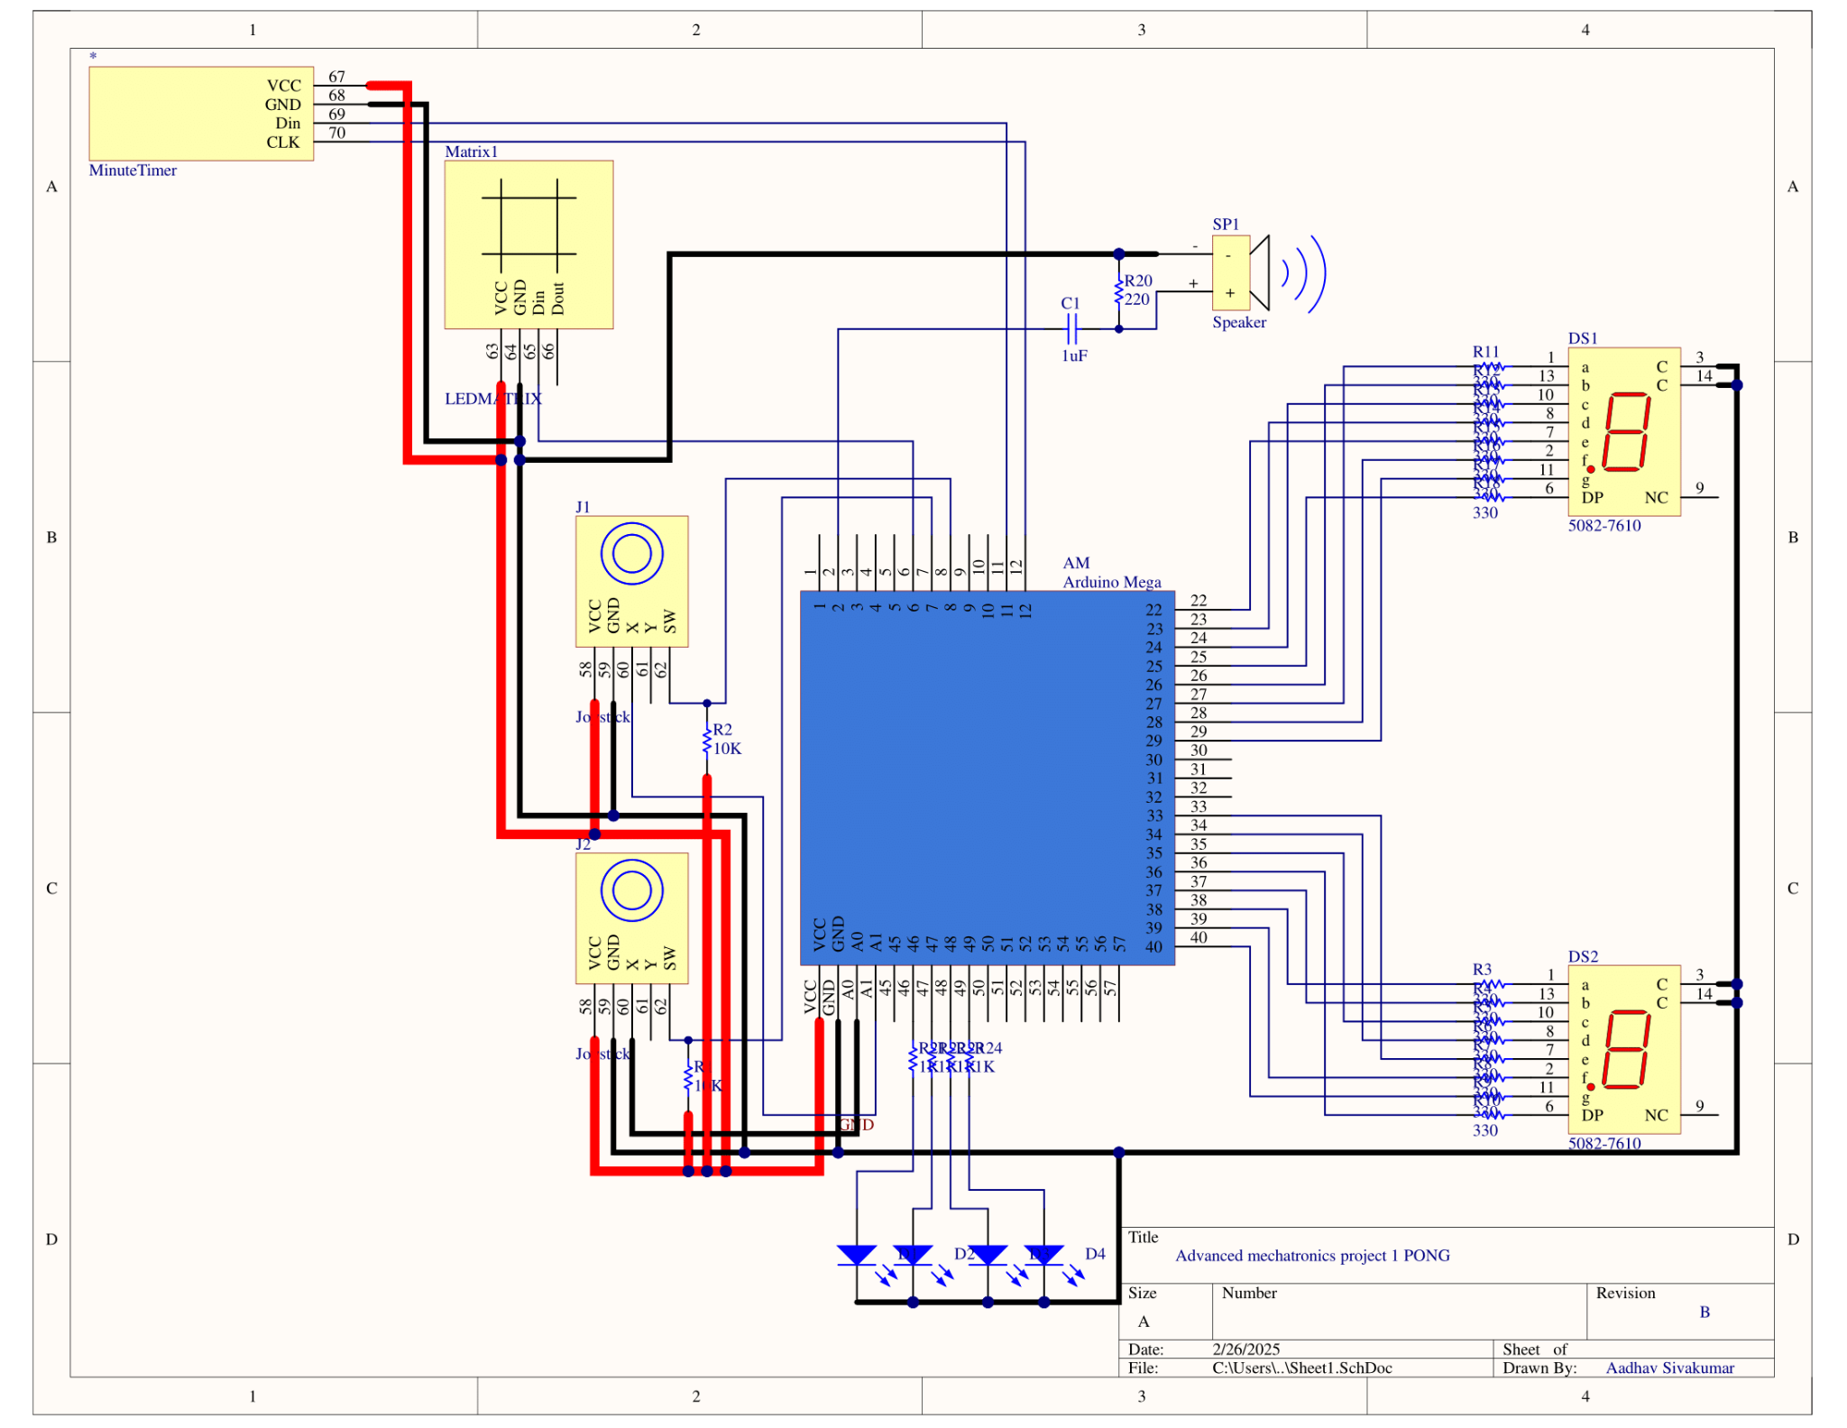
Circuit
Diagram
Notes:
Aadhav

Slide 8
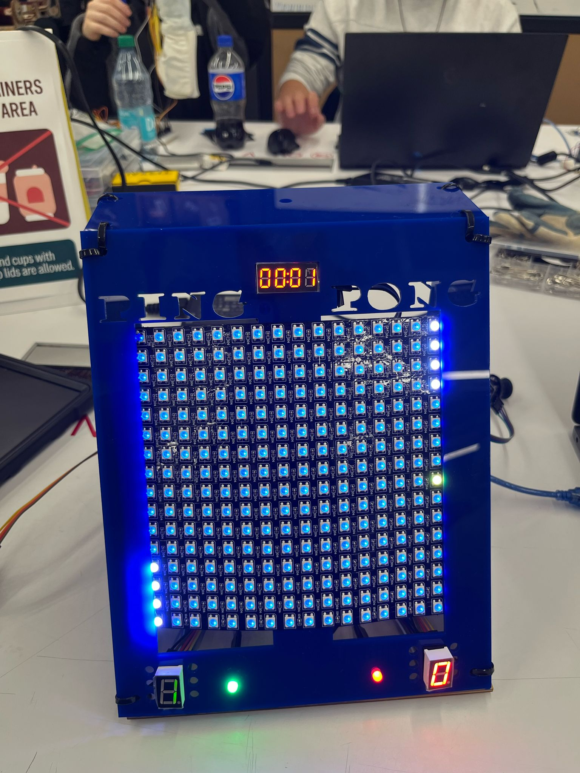
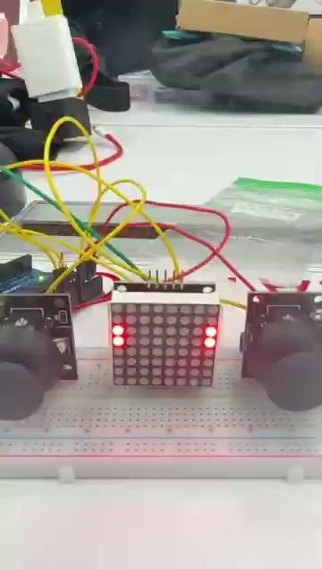
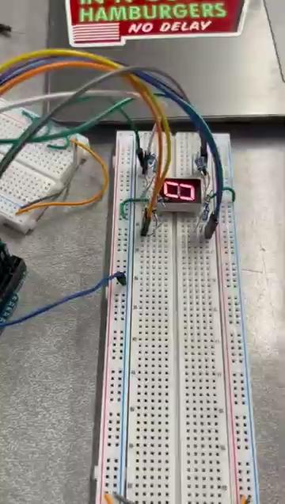
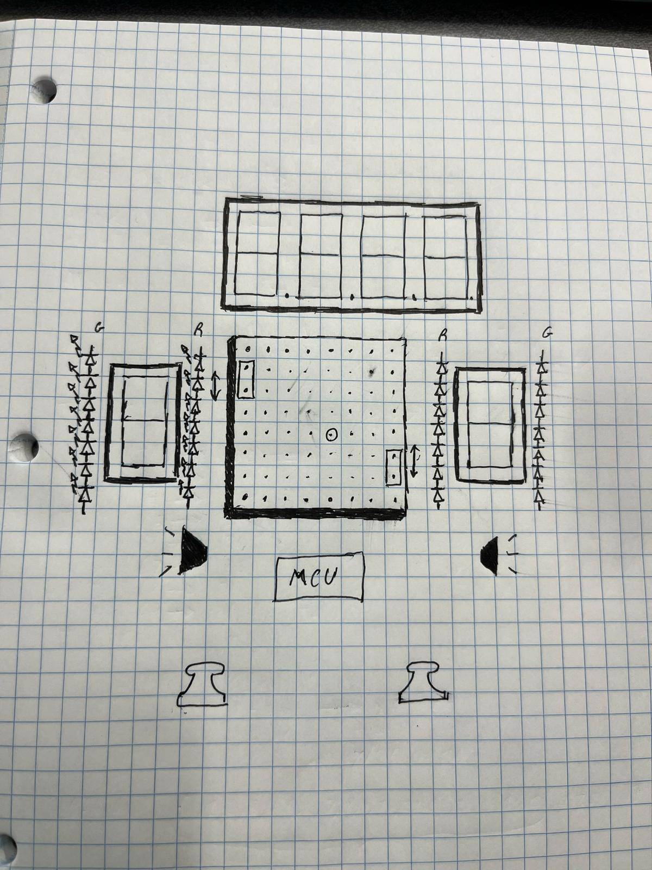
Progress
Notes:
Greta

Slide 9
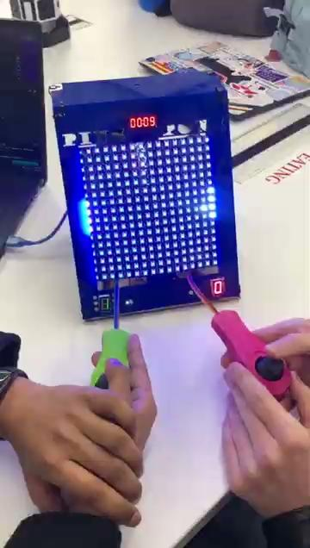
Video Demo
Notes:
Greta

Slide 10
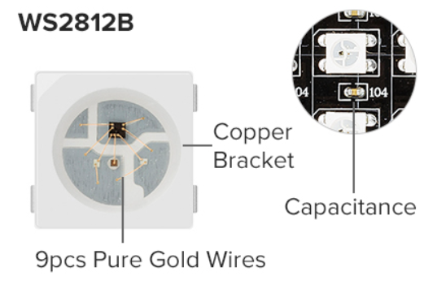
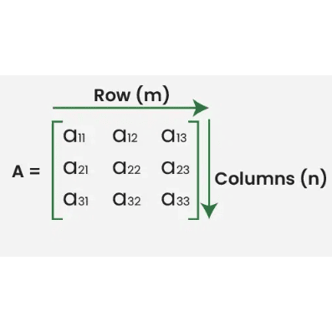
16x16 LED Matrix
Max Draw of 75 Watts, needs lower brightness level to stay under current draw max of the arduino
Color order : G R B（NOT RGB）
When you light up 1 color（red or green or blue, 0.1W/LED .
Notes:
Aadhav

Slide 11
Joystick
Module requires Vcc (5V) & GND for Inputs.
There are two analog outputs for the signal,
1 for the movement in the x-axis
1 for the movement in the y-axis
*y-axis pin not necessary given 1D movement
1 Digital Output, which is a pull-down switch,
Leaves floating voltage when joystick isn't pressed and pulling it to ground when it is
In the circuit there is a LARGE pull-up resistor connected to the pin such that the voltage isn't floating when switch is not pressed.
Notes:
Aadhav

Slide 12
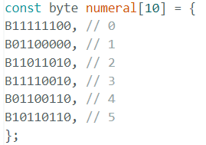
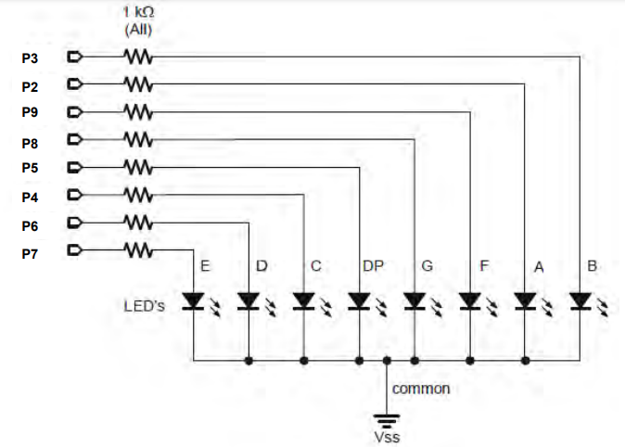
Single Digit 8-Seg LED Display
Common Cathode
Essentially 8 LEDs, each requiring a GPIO pin, constructed in a unique array
const byte segmentPins1[8] = {25,29,28,22,23,24,26,27};
// DP, G, F, E, D, C, B, A
Multiplexers (Mux) were considered
A Mux would decrease the Pin Count
High power draw of Matrix, mux would draw unnecessary power
Displays the current score
Notes:
Nate

Slide 13
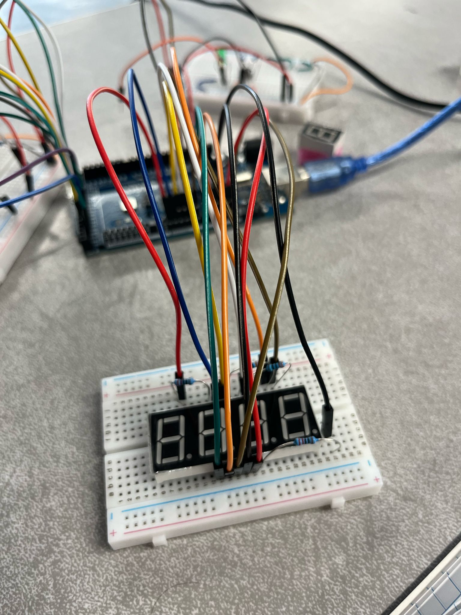
4-Digit Display w/ TM1637 Driver
Displays clock value going from 0 s to 1 min
If game reaches 1 min, game will end
Typically, 12 pins with common anode
The TM1637 Driver minimizes pins through a Mux that reduces the Pin Count to 4
Vcc, DIO, CLK, GND
2 wire comm. (DIO/CLK), but this is NOT a TWI device
Protocols are similar with a START/STOP procedure
0x08 → Max. brightness
0x40 → Ready for comm.
0x0c → First to write
Use of millis() for a non-blocking delay
Notes:
Nate

Slide 14
Tri-Color LED
Similar to a traditional LED
Indicates to the players who scored/lost
Only require 2 Pins: Green, Red
Notes:
Nate

Slide 15
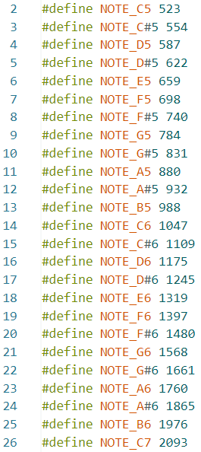
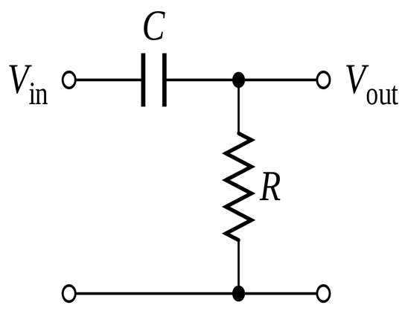
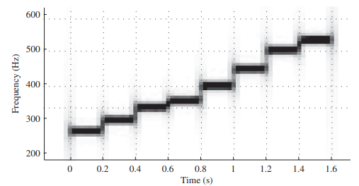
SFM-27 Buzzer Module
Anode → GPIO PWM Pin
Cathode → GND
High Pass filter to smooth out the sound
Use of tone() function
Generates square wave of the specified freq (50% duty cycle) on pin
Arrays of notes for
P1 Hit
P2 Hit
Goal
Game Over
Notes:
Nate

Slide 16
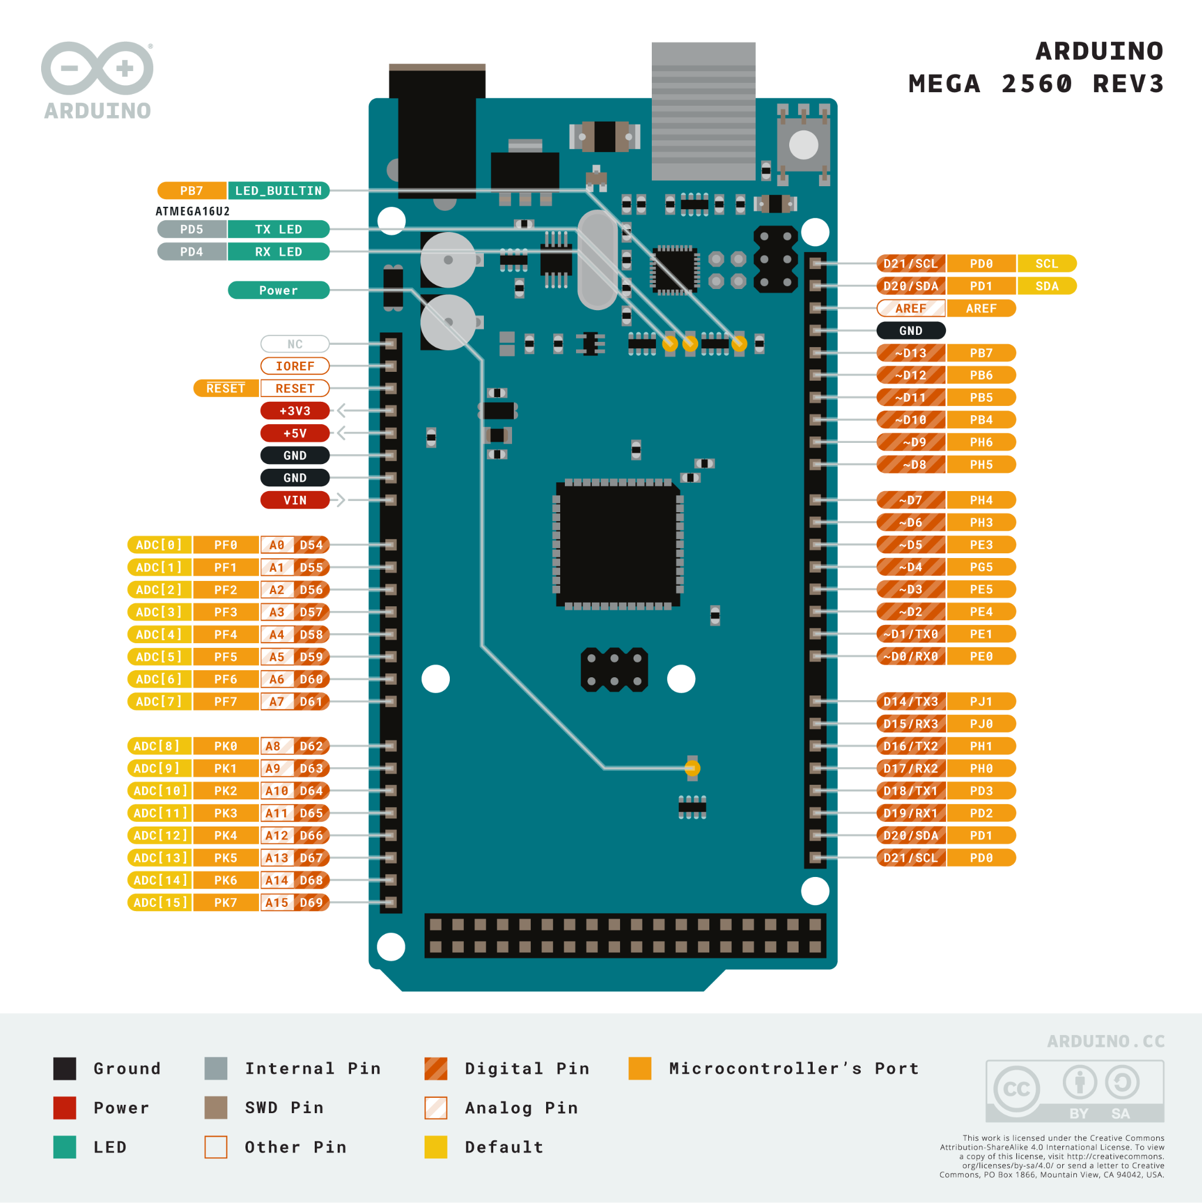
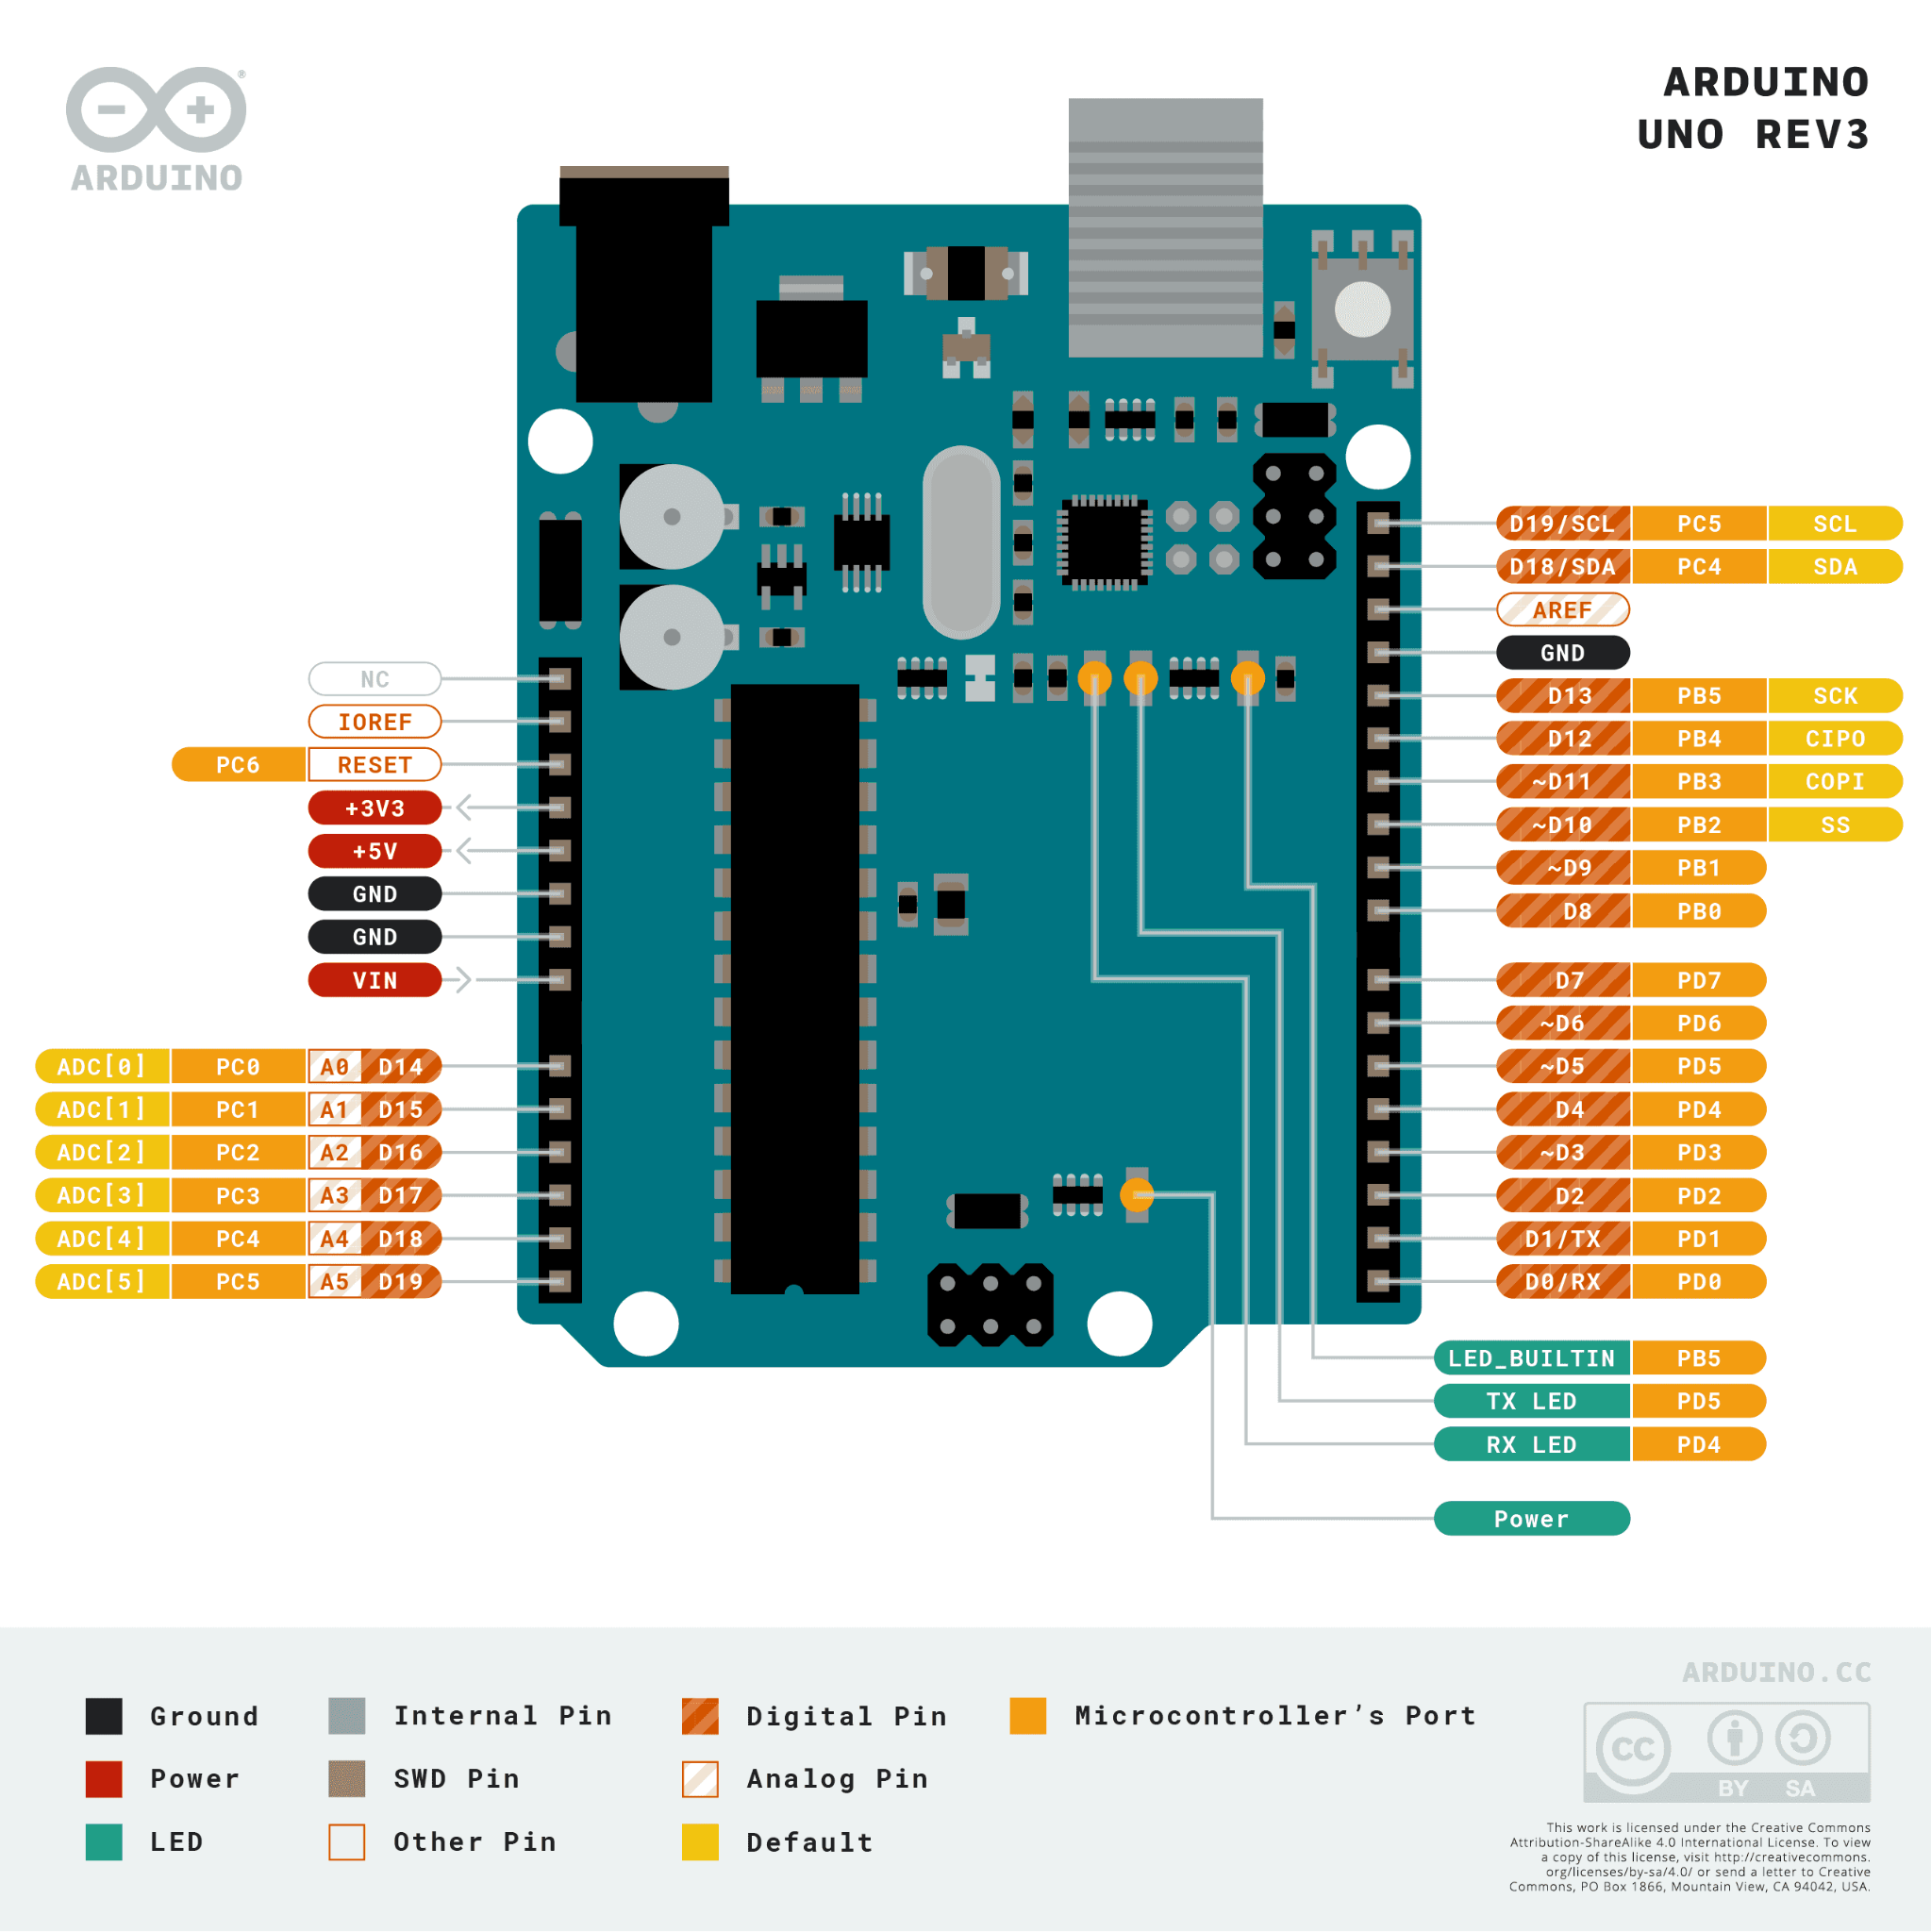
Arduino Mega 2560
54 Digital I/Os (14 support PWM Output)
ATmega2560 Processor
16 MHz clock speed
256kB flash memory
Originally attempted to implement this on UNO variant (Kuman UNO)
16 pins for both 1-Digit Displays
4 pins for both joysticks
4 pins for both tri-color LEDs
2 pins for 4-Digit Display
1 pin for Buzzer Module
1 pin for LED Matrix
28 pins TOTAL
Notes:
Aadhav

Slide 17
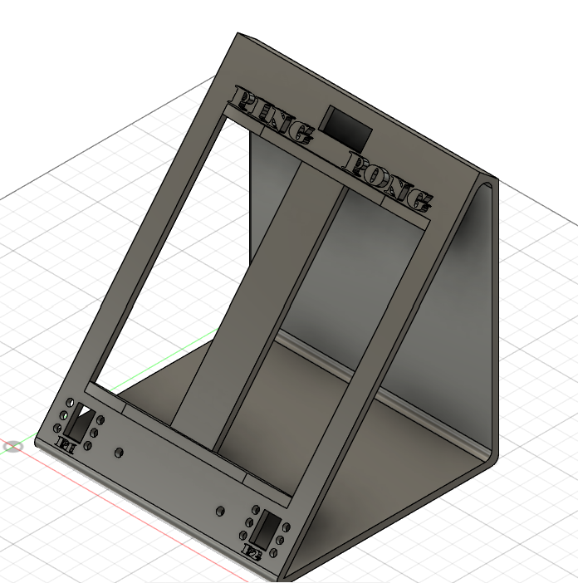
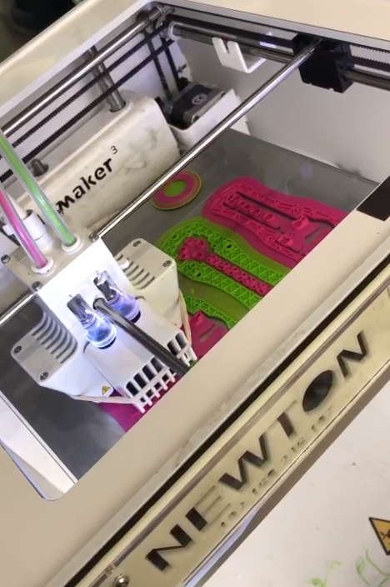
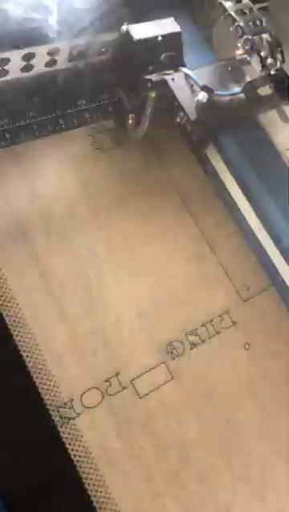
Housing
3D Printed Joysticks to go along with the housing
Laser Cut Wood Base and Acrylic Casing
Designed to house and protect the electronics
Curved LED Matrix Display for aesthetics
Proper tolerances for the counters, clock, and LED lights
The joystick is stored in an ergonomically designed housing made of PLA.
LED Matrix: Length x Width x Height -16cm x 16cm x 0.2cm
Notes:
Greta

Slide 18
Gantt Chart
SPRING 2025 | PING PONG!! GANTT CHART (Collaboration Plan)
 | Task | Team-Member | Week 1 | Week 2 | Week 3
 | Planned and ordered parts | Greta, Aadhav, Nate
 | Brainstormed Project Themes | Greta, Aadhav, Nate
 | Created a preliminary Blueprint | Nate
 | Tested functionality of individual parts (speakers, LED matrix, counters, clocks) | Greta, Aadhav, Nate
 | Created proof of concept: 8 x 8 LED matrix | Aadhav
 | Designing Housing / Joysticks | Greta
 | Manufacturing Housing / Joysticks | Greta
 | Programming | Aadhav, Nate
 | Assembly | Greta
 | Testing (Verification and Validation) | Greta, Aadhav, Nate
Notes:
Greta

Slide 19
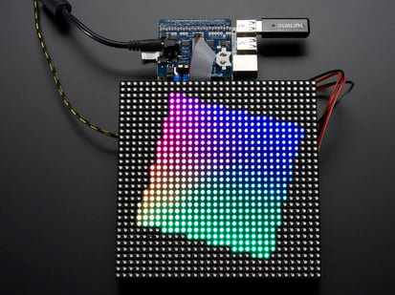
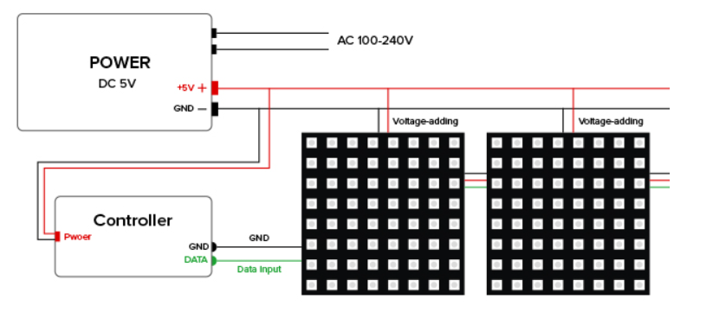
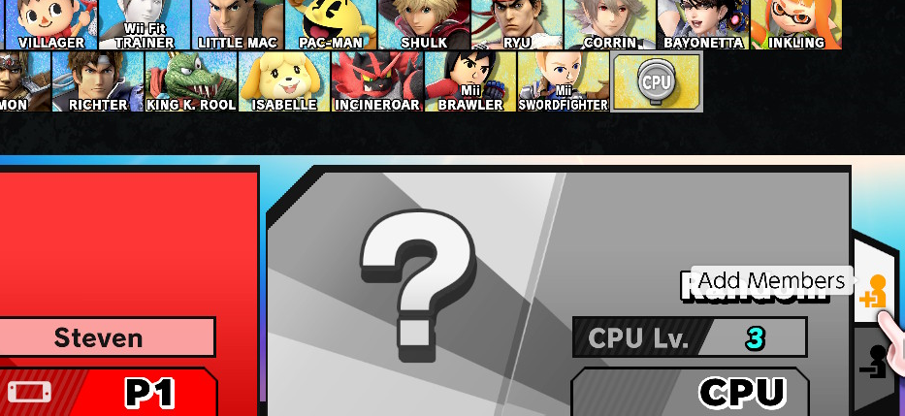
Future Work
Creating a larger display for more challenging gameplay
Better Resolution (More LEDs/Area)
Computer Played Unit (CPU)
Added Complexities (Multiple Balls)
Map paddle movement to real-life locomotion
Notes:
Nate

Slide 20
Would you like to play a game?
Notes:
Aadhav, Nate, Greta

